Slide 1

Chapter 11
Instruction Sets:
Addressing Modes and Formats

Slide 2

Addressing Modes
Immediate
Direct
Indirect
Register
Register Indirect
Displacement (Indexed)
Stack
Claims:
virtually all computer architectures provide more than one of these addressing modes
interpretation of the effective address (EA)
Tanpa virtual memory: EA=> memory dan register
Dengan virtual memory: EA => virtual memory dan register. Mapping pada MMU tersembunyi dari programmer
Notes:
2

Slide 3
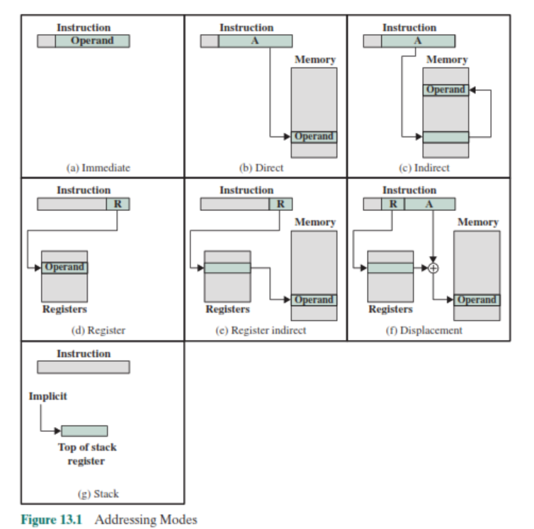
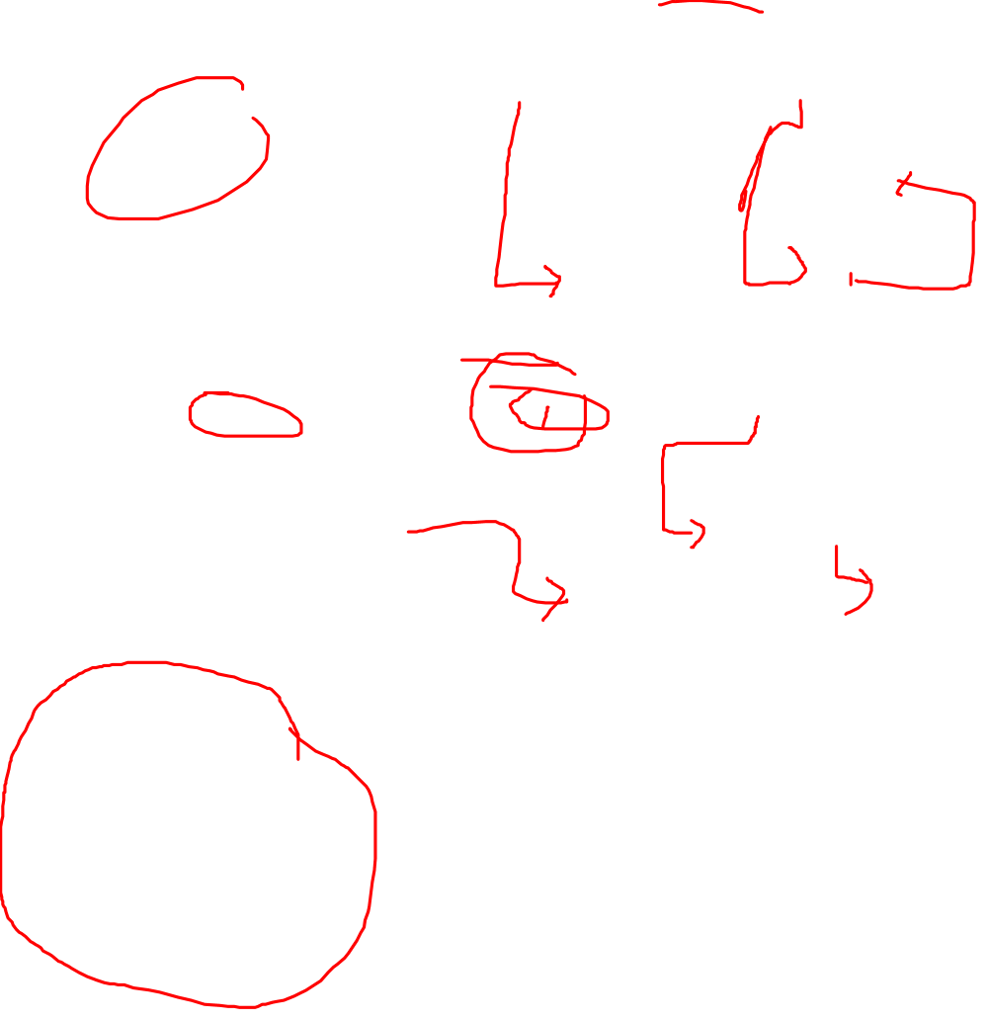

Slide 4
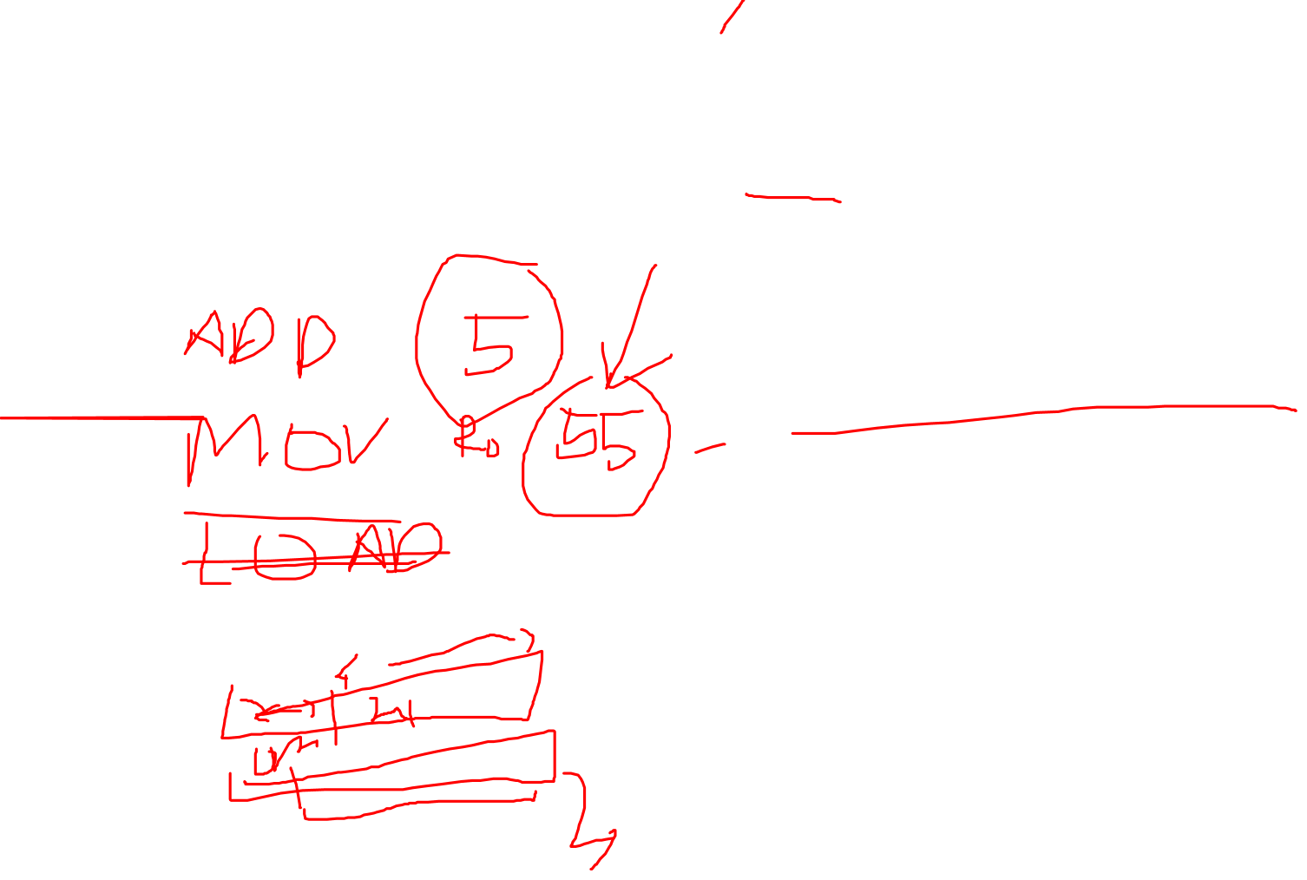
Immediate Addressing
Operand is part of instruction
Operand = address field
e.g. ADD 5
Add 5 to contents of accumulator
5 is operand
No memory reference to fetch data
Fast : karena tidak perlu mengambil ke memory
Limited range: karena instruction format biasanya mempunyai format yang ringkas (bisa jd hanya berapa byte saja, sementar angka itu bisa terdiri dari word, double word dan lain-lain)
Notes:
3

Slide 5

Immediate Addressing Diagram
Instruction
Opcode
Operand
Notes:
4

Slide 6
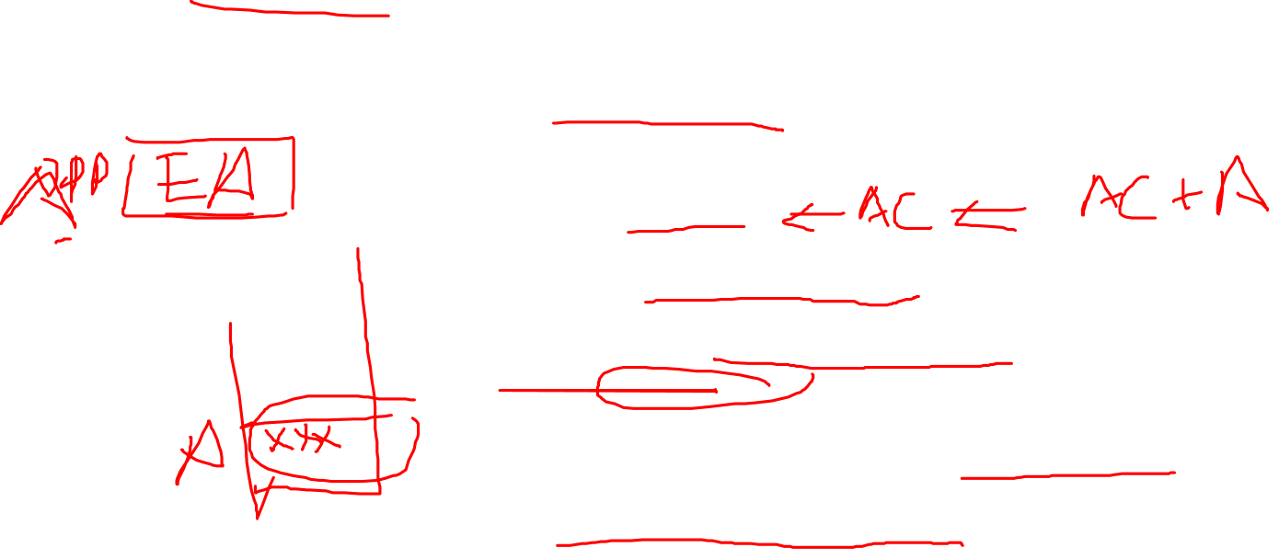
Direct Addressing
Address field contains address of operand
Effective address (EA) = address field (A)
e.g. ADD A
Add contents of cell A to accumulator
Look in memory at address A for operand
Single memory reference to access data
No additional calculations to work out effective address
Limited address space
Notes:
5

Slide 7
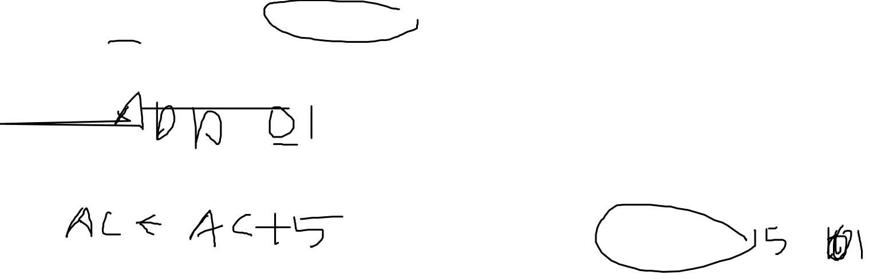
Direct Addressing Diagram
Instruction
Opcode
Address A
Memory
Operand
Notes:
6

Slide 8
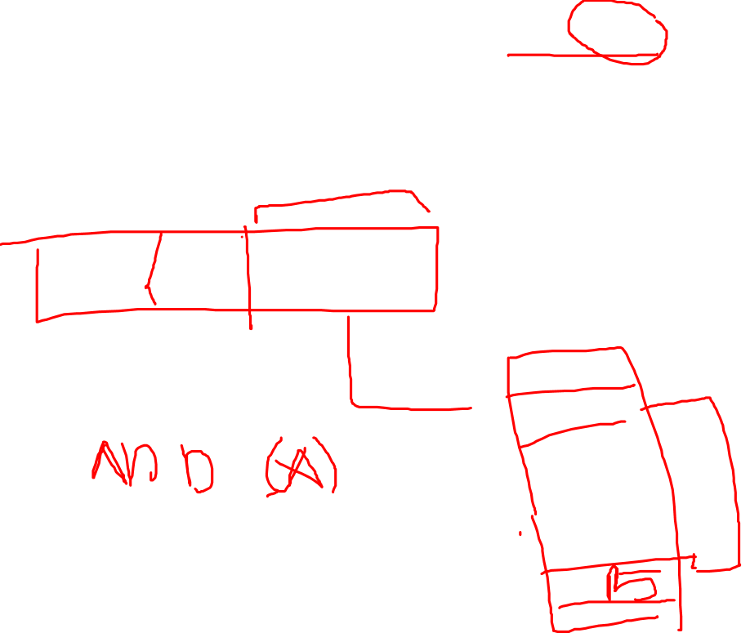
Indirect Addressing (1)
Memory cell pointed to by address field contains the address of (pointer to) the operand
EA = (A)
Look in A, find address (A) and look there for operand
e.g. ADD (A)
Add contents of cell pointed to by contents of A to accumulator
Notes:
7

Slide 9
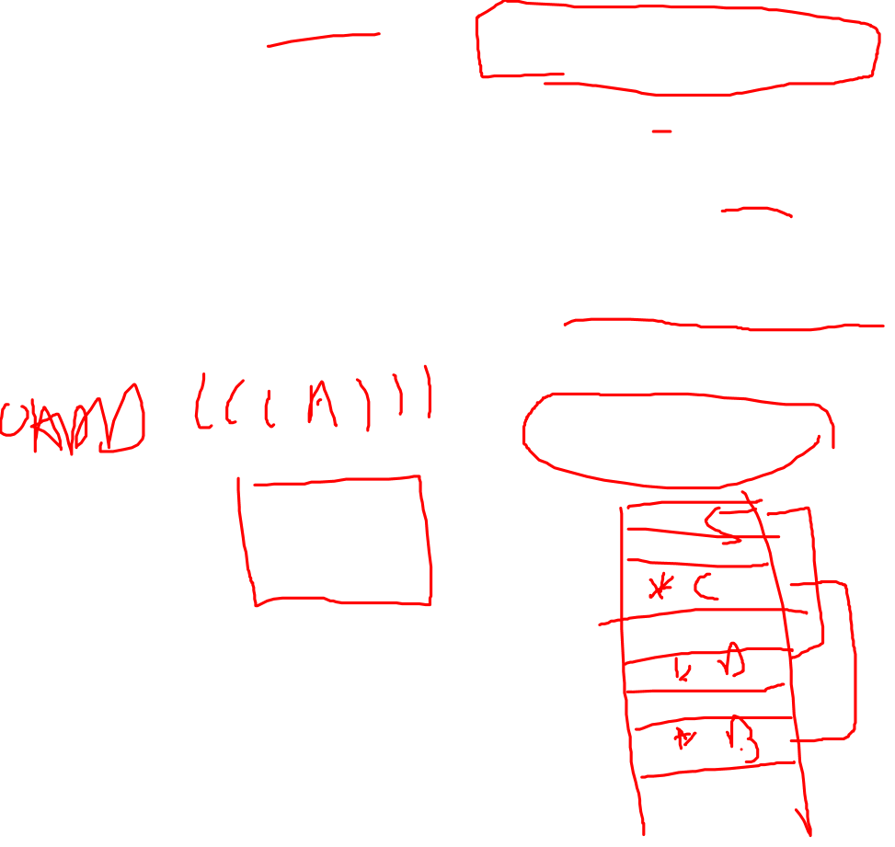
Indirect Addressing (2)
Large address space
May be nested, multilevel, cascaded
e.g. EA = (((A)))
Draw the diagram yourself
Multiple memory accesses to find operand
Hence slower
Notes:
8

Slide 10
Indirect Addressing Diagram
Instruction
Opcode
Address A
Memory
Pointer to operand
Operand
Notes:
9

Slide 11

Register Addressing (1)
Operand is held in register named in address filed
EA = R
Limited number of registers
Very small address field needed
Shorter instructions
Faster instruction fetch
Notes:
10

Slide 12

Register Addressing (2)
No memory access
Very fast execution
Very limited address space
Multiple registers helps performance
Requires good assembly programming or compiler writing
N.B. C programming
register int a;
c.f. Direct addressing
Notes:
11

Slide 13

Register Addressing Diagram
Instruction
Opcode
Register Address R
Registers
Operand
Notes:
12

Slide 14
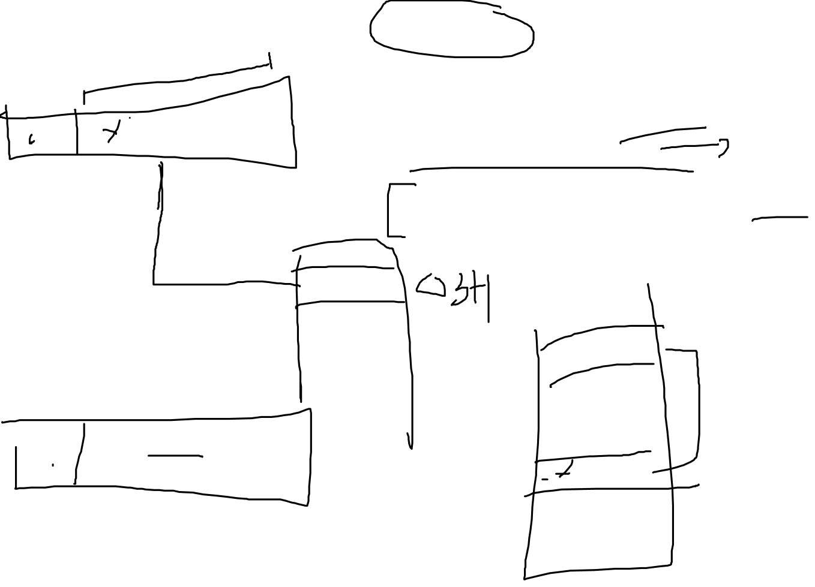
Register Indirect Addressing
C.f. indirect addressing
EA = (R)
Operand is in memory cell pointed to by contents of register R
Large address space (2^{n})
One fewer memory access than indirect addressing
Notes:
13

Slide 15

Register Indirect Addressing Diagram
Instruction
Opcode
Register Address R
Memory
Registers
Pointer to Operand
Operand
Notes:
14

Slide 16
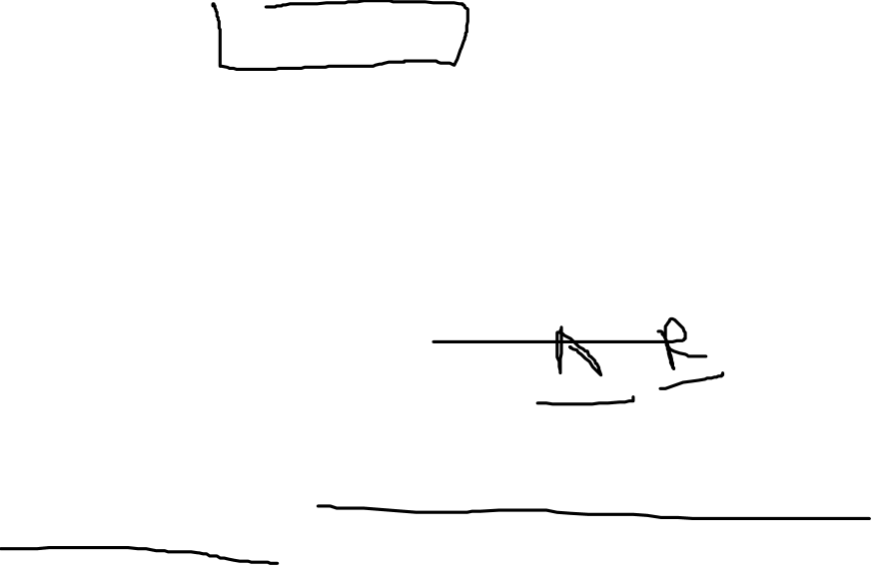
Displacement Addressing
EA = A + (R)
Address field hold two values
A = base value
R = register that holds displacement
or vice versa
A very powerful mode of addressing combines the capabilities of direct addressing and register indirect addressing
Displacement addressing requires that the instruction have two address fields, at least one of which is explicit
Notes:
15

Slide 17
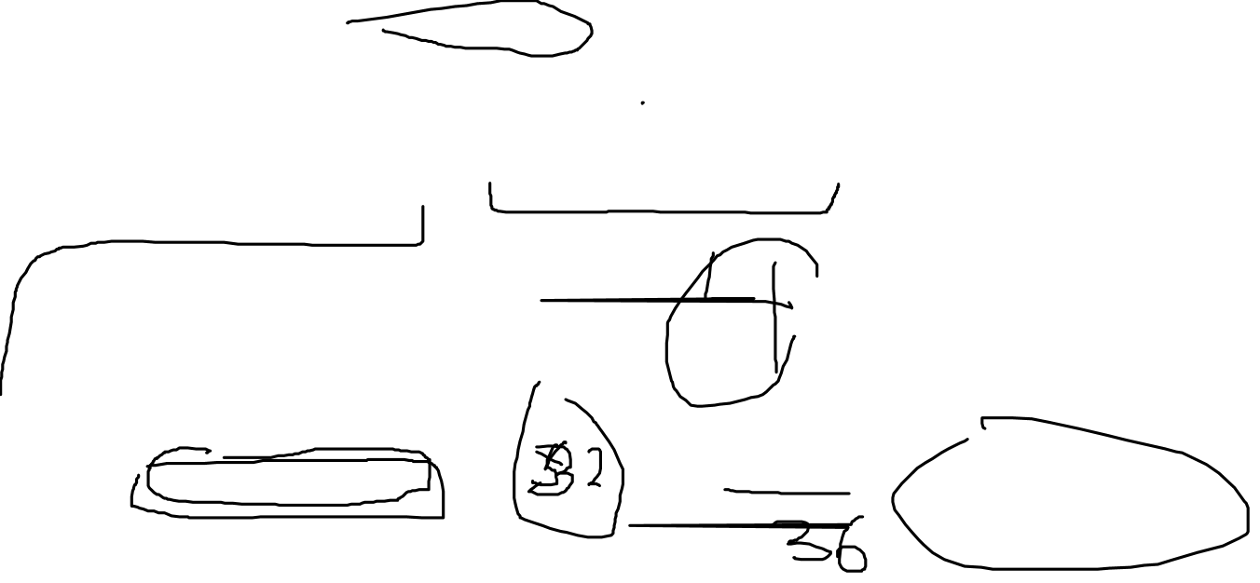
Displacement Addressing Diagram
Instruction
Opcode
Register R
Address A
Memory
Registers
Pointer to Operand
+
Operand
Notes:
16

Slide 18
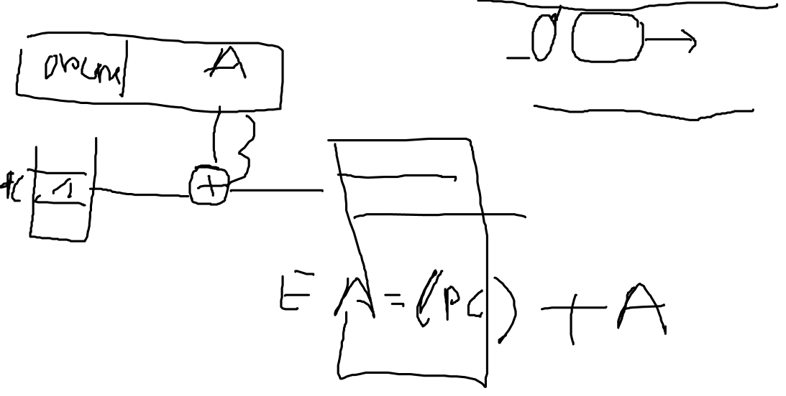
Relative Addressing
A version of displacement addressing
R = Program counter, PC
EA = A + (PC)
i.e. get operand from A cells from current location pointed to by PC
c.f locality of reference & cache usage
Notes:
17

Slide 19
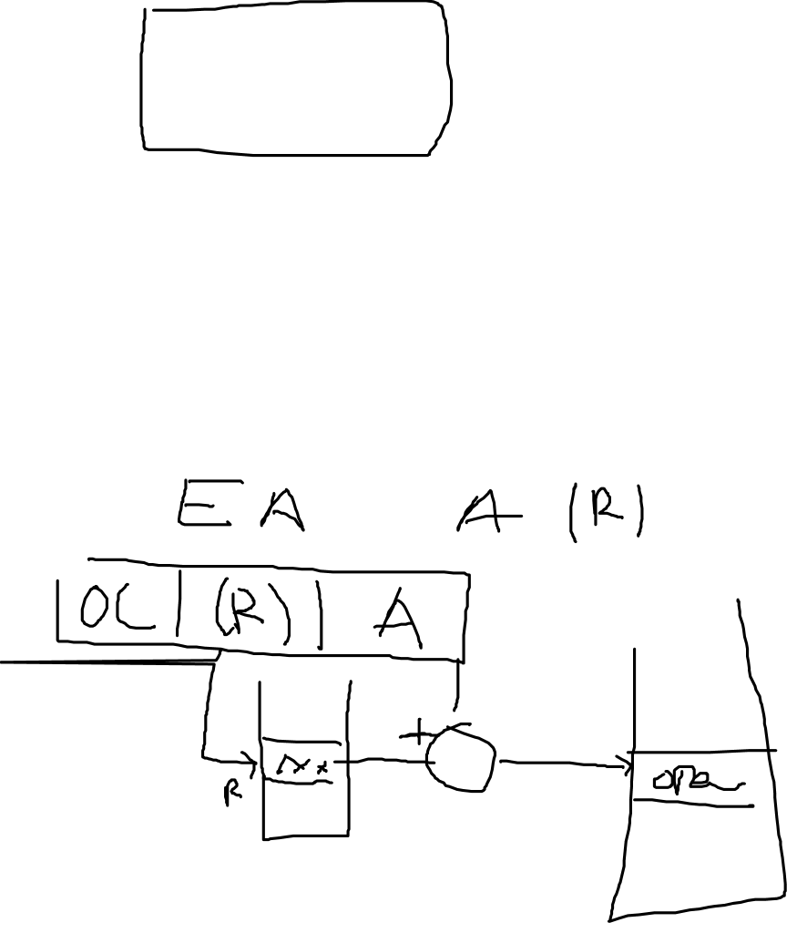
Base-Register Addressing
A holds displacement
R holds pointer to base address
R may be explicit or implicit
e.g. segment registers in 80x86
The referenced register contains a main memory address, and the
address field contains a displacement (usually an unsigned integer representation) from that address.
Notes:
18

Slide 20
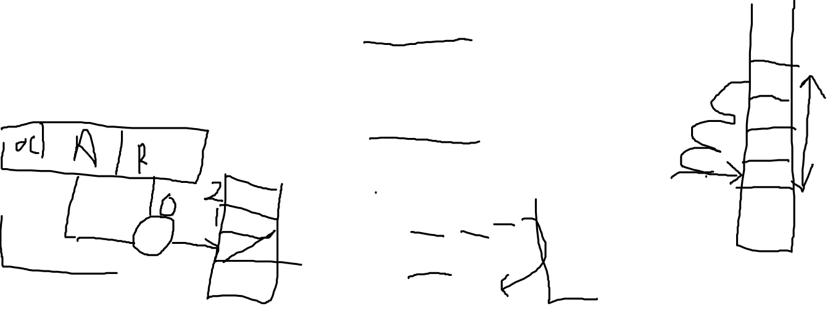
Indexed Addressing
A = base
R = displacement
EA = A + R
Good for accessing arrays
EA = A + R
R++
The address field references a main memory address, and the referenced register contains a positive displacement from that address
Notes:
19

Slide 21
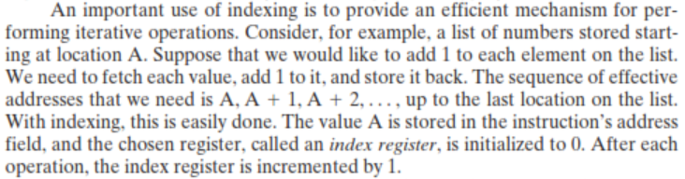
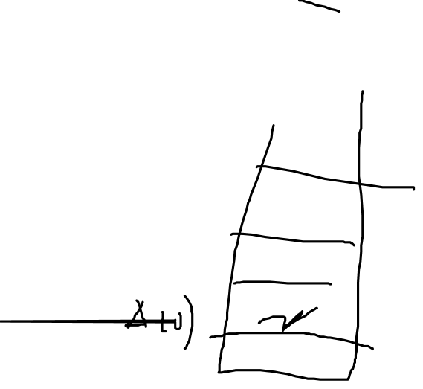

Slide 22
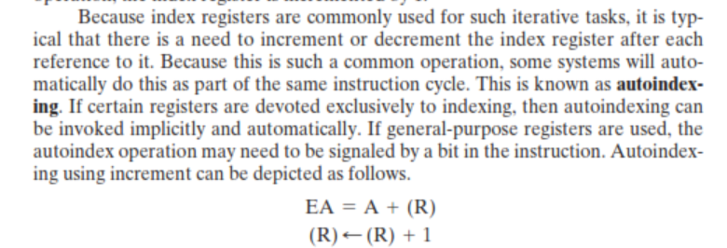
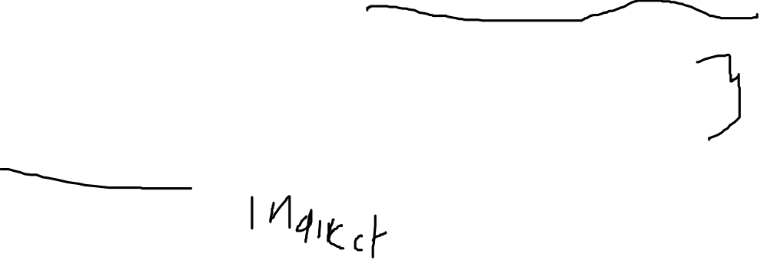
Auto Indexing
Auto Indexing
Notes:
20

Slide 23
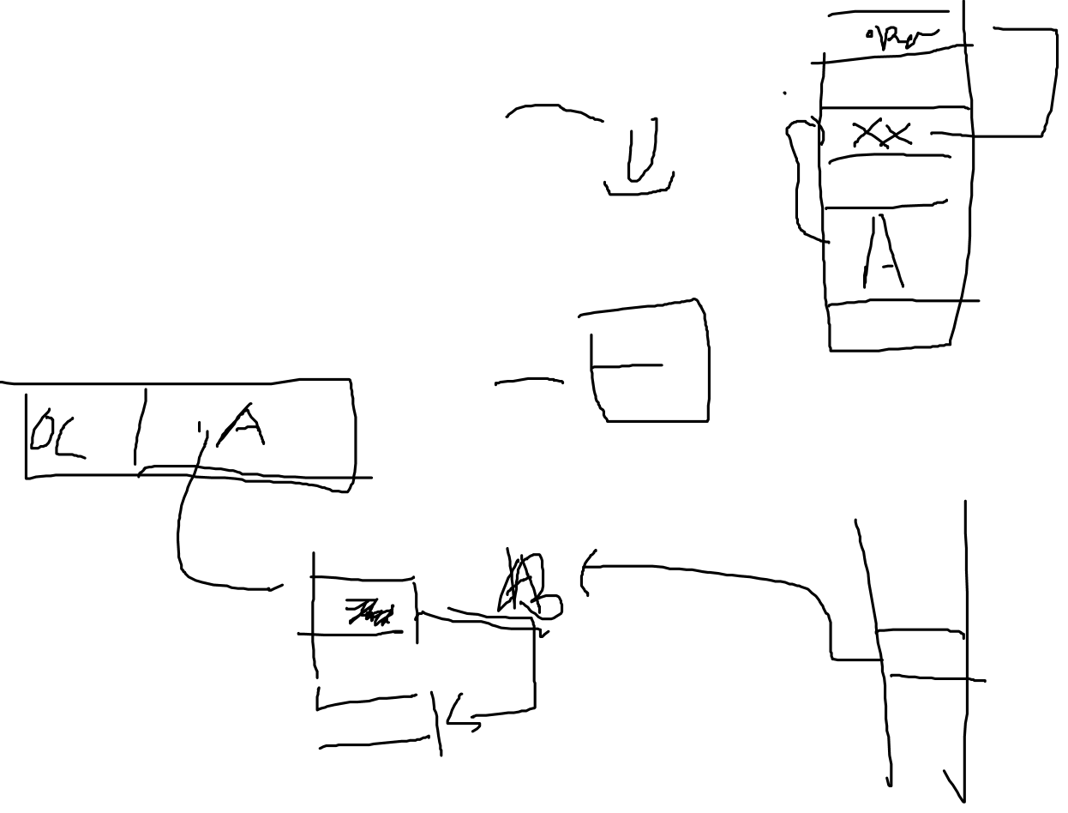
Combination (indirect+index)
Postindex
EA = (A) + (R)
Preindex
EA = (A+(R))
(Draw the diagrams)

Slide 24
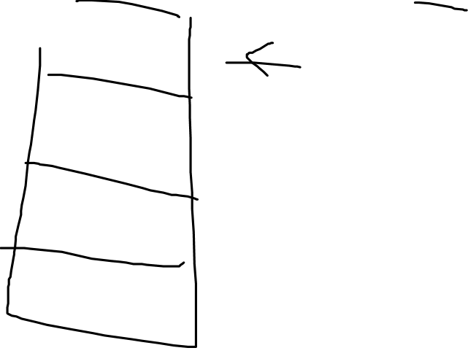
Stack Addressing
Operand is (implicitly) on top of stack
e.g.
ADD Pop top two items from stack and add
Notes:
21

Slide 25
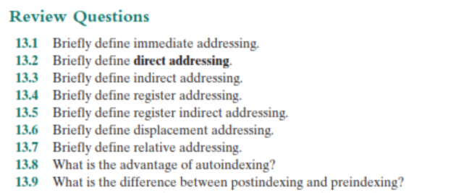
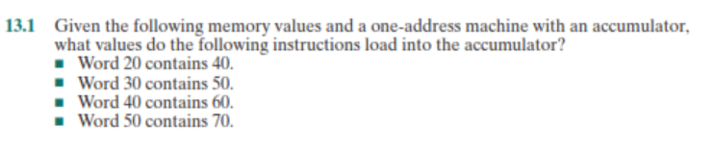
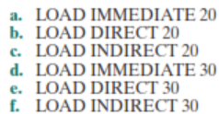

Slide 26
